Slide 1
ASR GENERATION: GENERATING POWER DURING THE INJECTION CYCLE OF AN ASR PROJECT
PRESENTED BY:
KENT MADISON
OWNER – 3R VALVE, LLC
&
MATTHEW JOHNSON, P.E.
OWNER – WAPITI CONSULTING, LLC.

Slide 2
WHAT IS AR AND ASR?
Aquifer recharge (AR) and aquifer storage and recovery (ASR) are manmade processes or natural processes enhanced by humans that convey water underground. The processes replenish ground water stored in aquifers for beneficial purposes. Although AR and ASR are often used interchangeably, they are separate processes with distinct objectives. AR is used solely to replenish water in aquifers. ASR is used to store water, which is later recovered for use.
www.epa.gov/uic/aquifer-recharge-and-aquifer-storage-and-recovery

Slide 3
AR AND ASR POWER REGENERATION
During aquifer recharge or aquifer storage process, the pumping motor is allowed to run in reverse therefore converted to a generator.
Works in both submersible pumps and above ground vertical line shaft applications.
Motor starting requirements:
VFD (Variable Frequency Drive), Soft Starter, Across the Line
Power regeneration requirements:
VFD (Variable Frequency Drive) Regeneration Drive

Slide 4
BENEFITS OF AR AND ASR POWER REGENERATION DURING AQUIFER INJECTION
Reduce net kilowatt hours paid for pumping municipal, industrial or agricultural water.
Reduce consumer electrical grid footprint.
Existing installations have shown a quick payback on capital investments.
Overall public perception.
Possible utility credit.

Slide 5
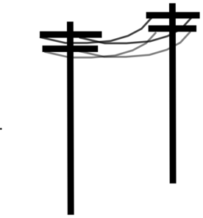
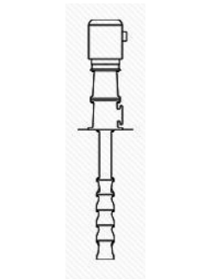
REGENERATION EXAMPLE 1 : AQUIFER INJECTION
MOTOR STARTER (VFD)
MOTOR STARTER (VFD)
UTILITY
POWER REGERATION VFD
WELL PUMP
WELL PUMP
SHALLOW AQUIFER
CONSUMER
DEEP AQUIFER

Slide 6
REGENERATION EXAMPLE 1 : AQUIFER RECOVERY
MOTOR STARTER (VFD)
UTILITY
POWER REGERATION VFD
WELL PUMP
WELL PUMP
SHALLOW AQUIFER
CONSUMER
DEEP AQUIFER

Slide 7
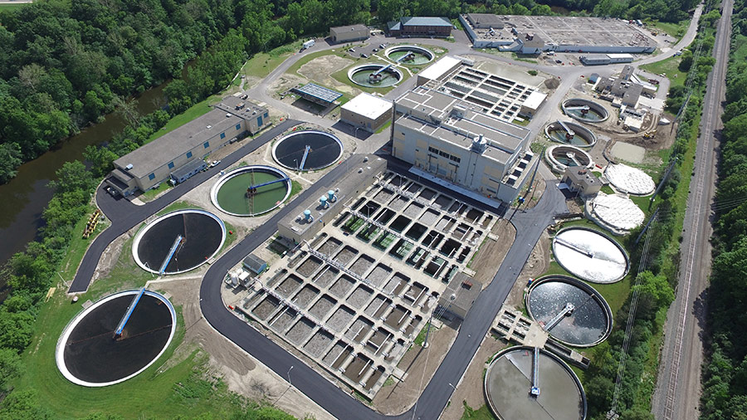
REGENERATION EXAMPLE 2 : AQUIFER INJECTION
MOTOR STARTER (VFD)
UTILITY
POWER REGERATION VFD
WELL PUMP
WASTEWATER SECONDARY TERTIARY TREATMENT WATER
CONSUMER
DEEP AQUIFER

Slide 8
REGENERATION EXAMPLE 2 : AQUIFER RECOVERY
MOTOR STARTER (VFD)
UTILITY
POWER REGERATION VFD
WELL PUMP
WASTEWATER SECONDARY TERTIARY TREATMENT WATER
CONSUMER
DEEP AQUIFER

Slide 9
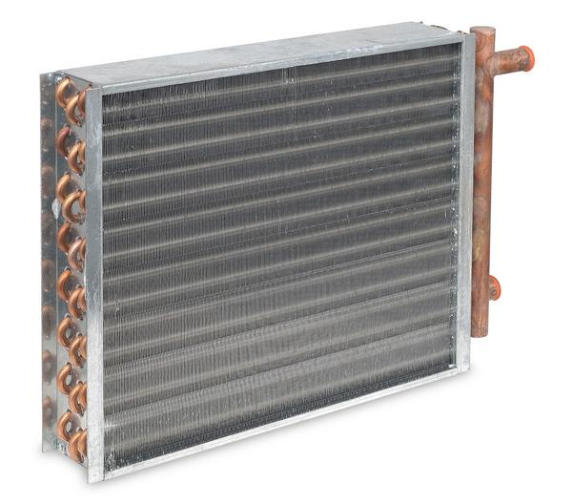
REGENERATION EXAMPLE 3 : AQUIFER INJECTION
MOTOR STARTER (VFD)
MOTOR STARTER (VFD)
UTILITY
POWER REGERATION VFD
WELL PUMP
WATER TO AIR HEAT EXCHANGER
IN AC MODE
COLD AQUIFER
WARM AQUIFER

Slide 10
REGENERATION EXAMPLE 3 : AQUIFER RECOVERY
MOTOR STARTER (VFD)
MOTOR STARTER (VFD)
UTILITY
POWER REGERATION VFD
WELL PUMP
WATER TO AIR HEAT EXCHANGER IN HEATING MODE
COLD AQUIFER
WARM AQUIFER

Slide 11
REGENERATION EXAMPLE 4 : AQUIFER INJECTION
MOTOR STARTER (VFD)
ASR VALVE
OPEN 1-50 %
SPIN MOTOR
UTILITY
POWER REGERATION VFD
ASR VALVE
OPEN 51-100 %
SPIN MOTOR & AQUIFER INJECTION
WASTEWATER SECONDARY TERTIARY TREATMENT WATER
WELL PUMP
CONSUMER
DEEP AQUIFER

Slide 12
REGENERATION EXAMPLE 4 : AQUIFER RECOVERY
MOTOR STARTER (VFD)
UTILITY
POWER REGERATION VFD
ASR VALVE
CLOSED 100 %
FOR PUMPING (RECOVERY)
WASTEWATER SECONDARY TERTIARY TREATMENT WATER
WELL PUMP
CONSUMER
DEEP AQUIFER

Slide 13
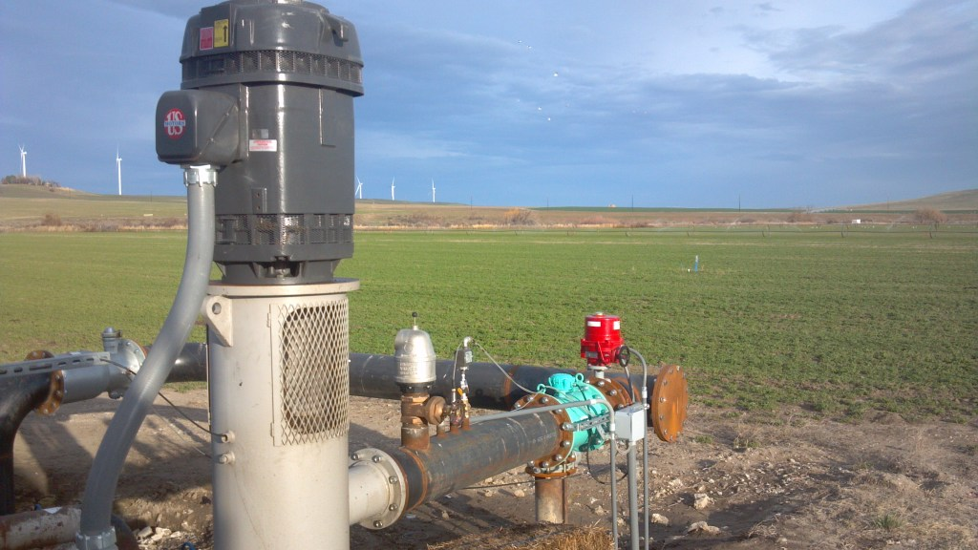
MADISON FARMS ECHO, OREGON ASR REGENERATION
200 HP MOTOR WITH VERTICAL LINE SHAFT PUMP – 8” PIPE, AQUIFER LEVEL 520 FEET BELOW LAND SURFACE.
200 HP MOTOR STARTING VFD & 100 HP REGENERATION VFD WITH LOCAL CONTROL PANEL.

Slide 14
200 HP MOTOR STARTING DRIVE (VFD) – RIGHT 100 HP POWER REGENERATION DRIVE (VFD) - LEFT

Slide 15
MADISON FARMS : SHALLOW WELL AND DEEP WELL ASR REGENERATION

Slide 16
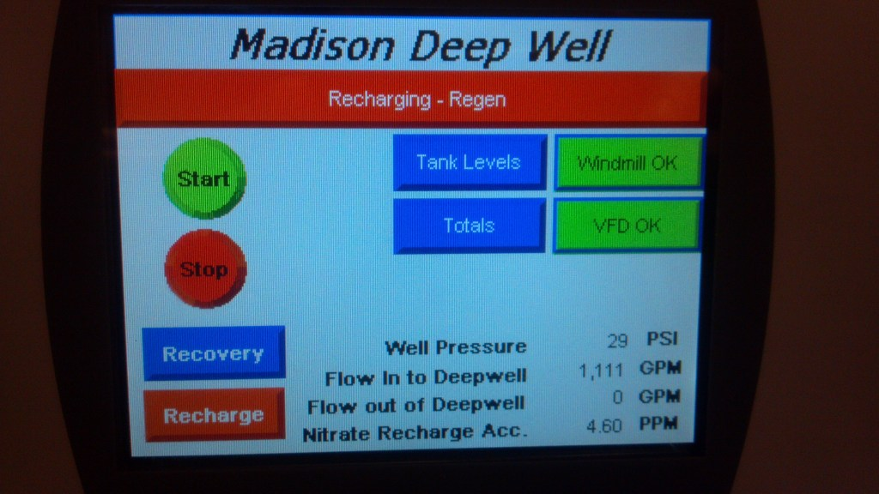
LOCAL CONTROL PANEL HMI SCREEN NO. 1

Slide 17
LOCAL CONTROL PANEL HMI SCREEN NO. 2

Slide 18
LOCAL CONTROL PANEL HMI SCREEN NO. 3

Slide 20
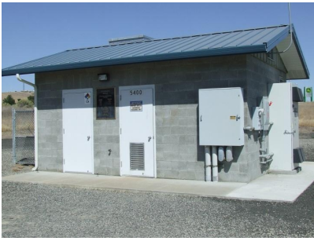
CITY OF PENDLETON,OREGON WELL NO. 14
WELL NO. 14
100 HP MOTOR
100 HP VFD STARTER
100 HP VFD REGENERATION DRIVE
12” PIPING
AQUIFER LEVEL 277 FEET
BELOW LAND SURFACE
WELL DATA PROVIDED BY
TIM SMITH
WATER DEPARTMENT SUPERINTENDENT

Slide 28
CONCLUSIONS
ASR POWER REGENERATION HAS THE ABILITY TO RECOVER OR RECAPUTURE CAPITAL INVESTMENTS.
ASR POWER REGENERATION IS A VALUED INVESTMENT FOR ANY NEW OR EXISTING ASR WELL SITE.
ASR POWER REGENERATION WILL REDUCE THE TOTAL POWER CONSUMPTION WHEN USED WITH ADDITIONAL LOADS.

Slide 29
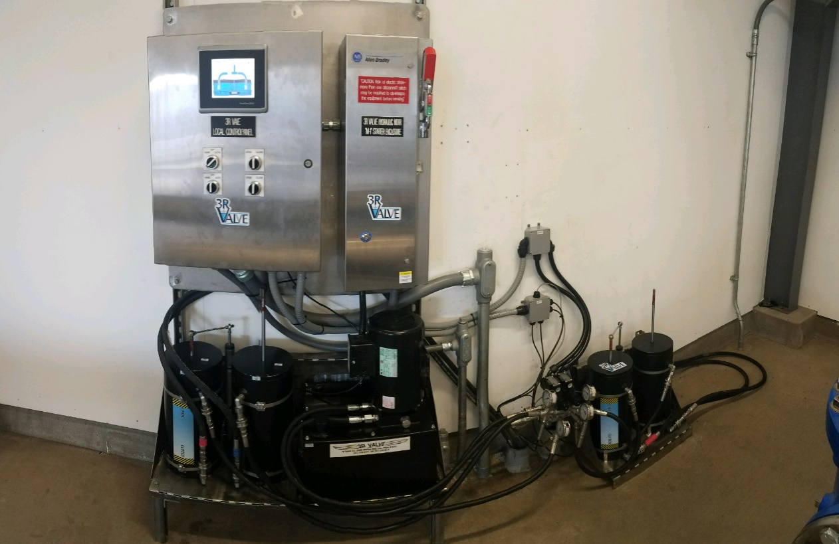
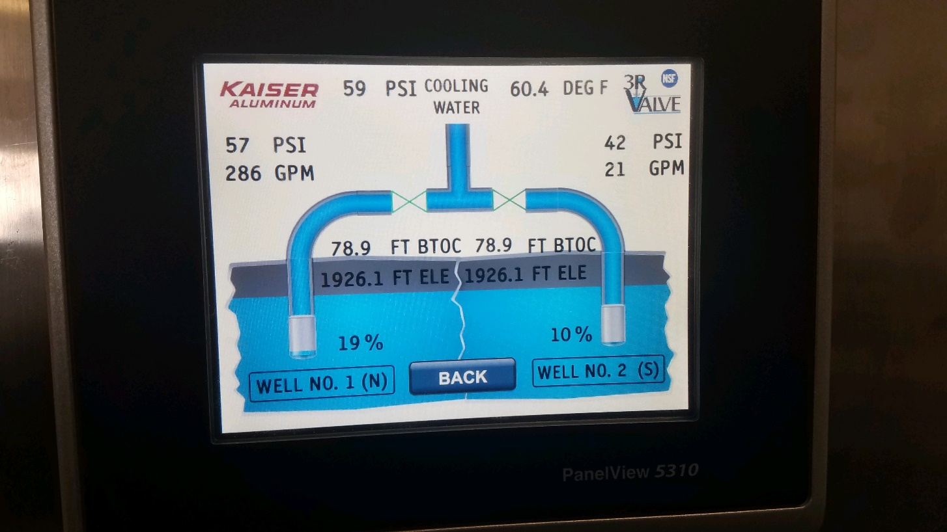
QUESTIONS OR COMMENTS?
KENT MADISON
3R VALVE, LLC
WWW.3RVALVE.COM
KMADISON@EONI.COM
(541) 571-0581
MATTHEW JOHNSON, P.E.
WAPITI CONSULTING, LLC
WWW.WAPITI-CONSULTING.COM
208WAPITICONSULTING@GMAIL.COM
(208) 651-1120

